Slide 1
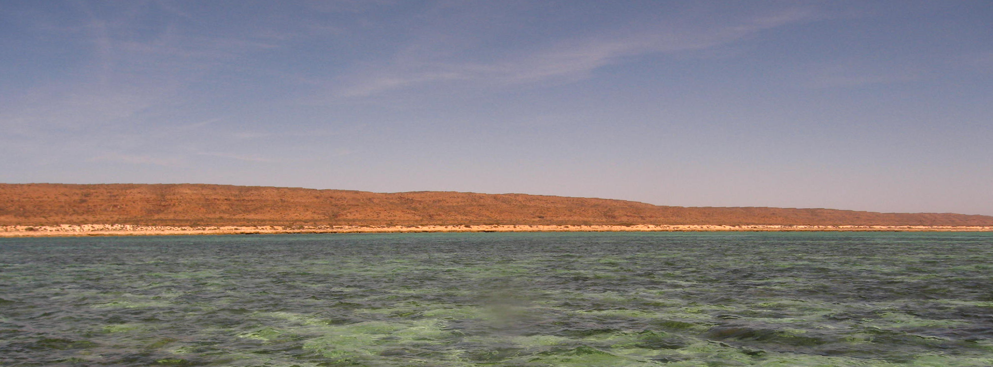
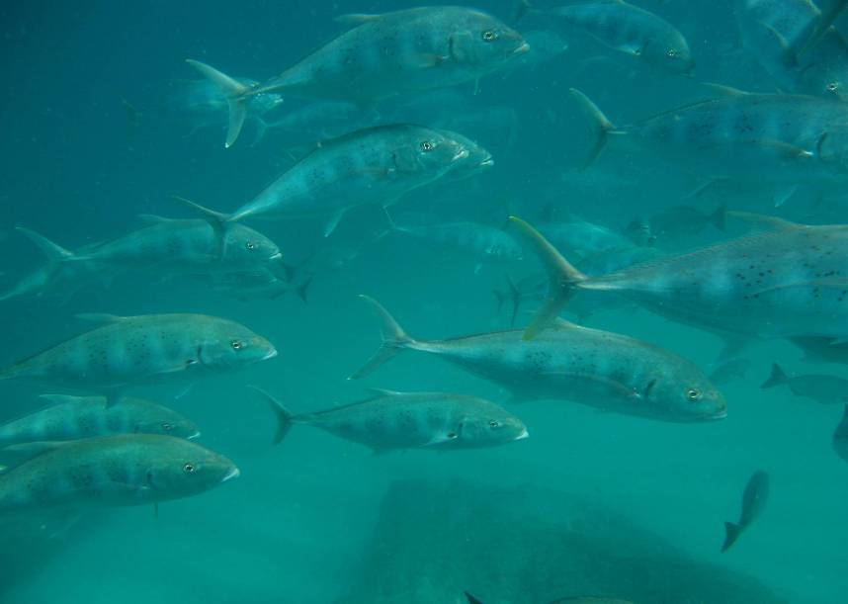

Evaluating the effectiveness of zoning at Ningaloo Reef Marine Park
Russ Babcock
9 July 2012
CSIRO Marine and Atmospheric Research / Wealth From Oceans Flagship

Slide 2
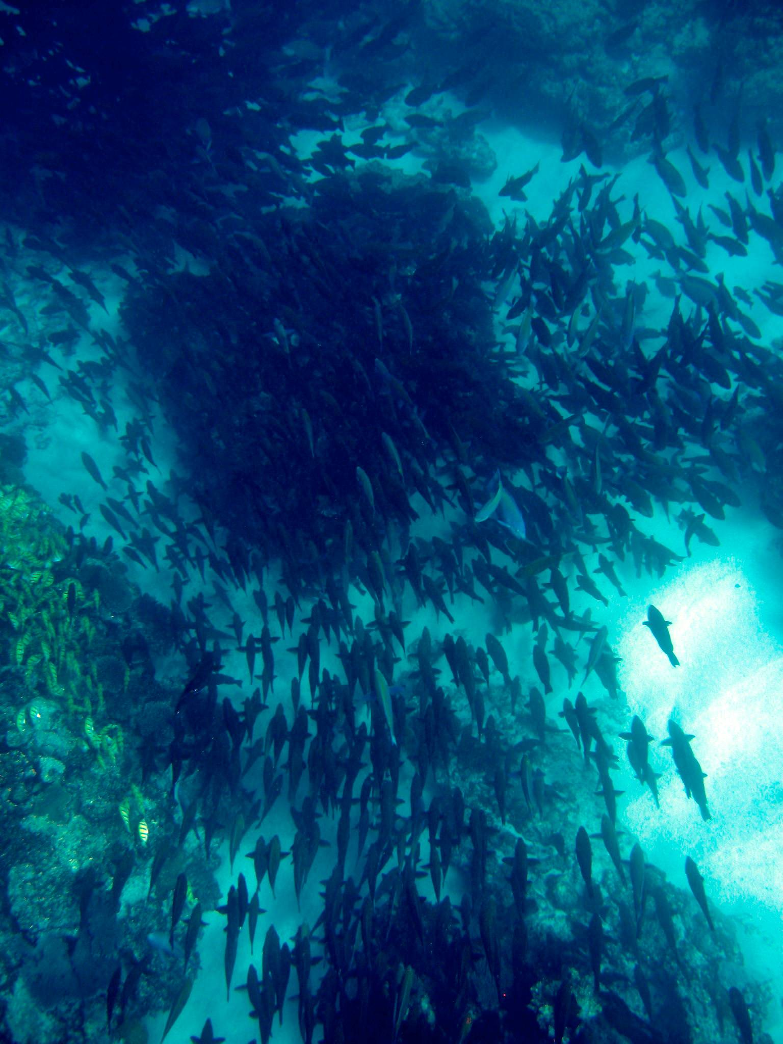
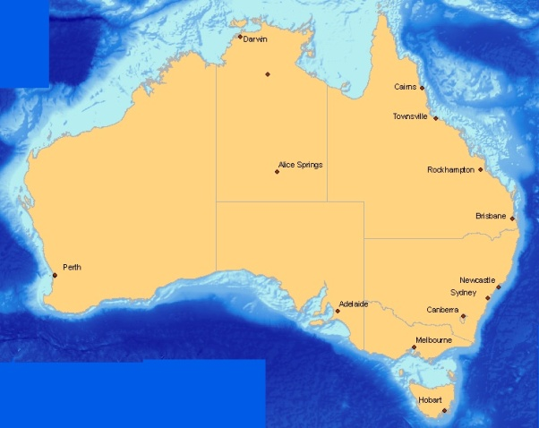
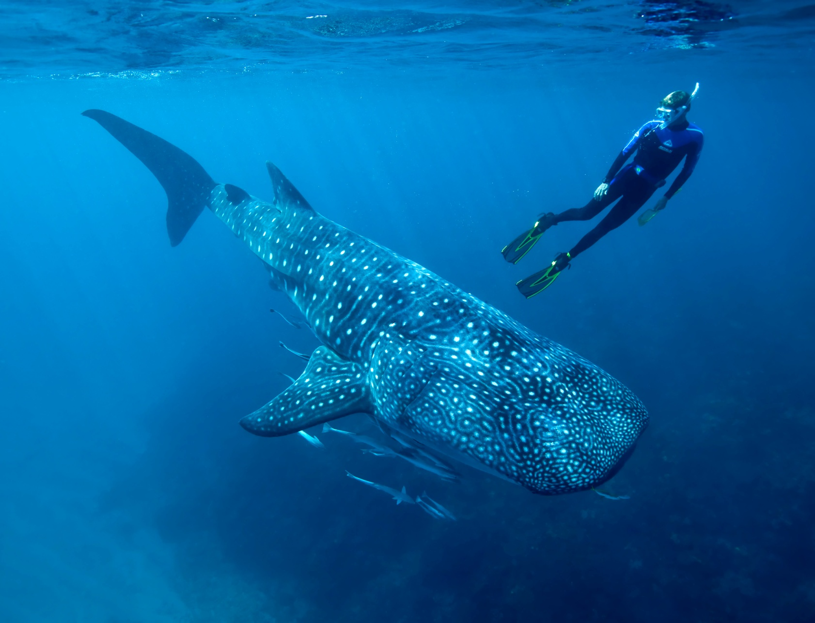
Ningaloo World Heritage Area

Slide 3
Rationale:
Are Sanctuary zones Adequate and Effective?
Measures of the zoning effectiveness: abundance and biomass of key fish species in historic no-take zones
Baseline data: overall abundance and size across the Marine Park
Adequacy of sanctuaries: effect of reserve size and fish movements
Adaptive management requires evidence in order to be effective

Slide 4
Sampling design
Stratified by:
Region (north central south)
Habitat (lagoon, reef-flat, reef slope)
Zoning
900+ transects
over 2 years

Slide 5
Effectiveness:
Biomass of key fish species in Sanctuary zones

Slide 6
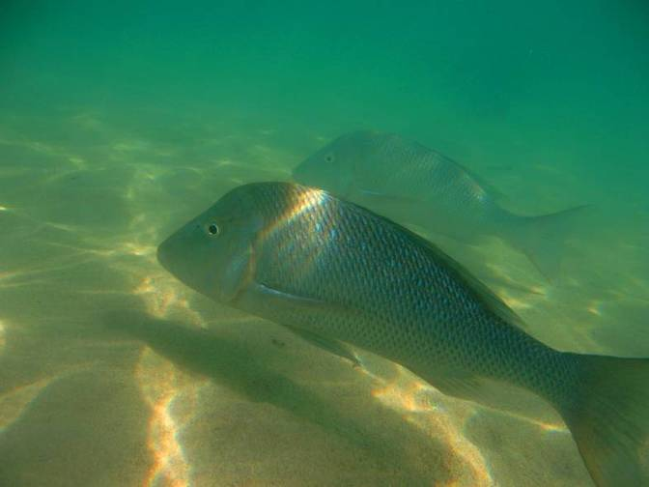
Zoning effects
Spangled Emperor Lethrinus nebulosus
Generalised predator/invertivore
Important fishing target species

Slide 7
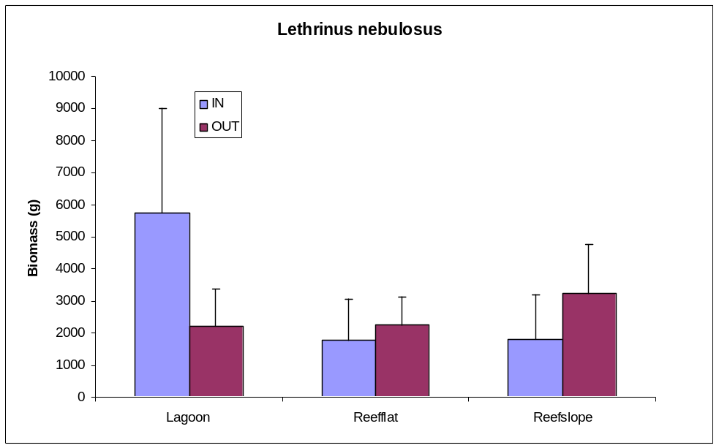
Zoning effects
Roughly 50% higher Spangled Emperor biomass in old sanctuary zones (p=0.014)
Most of the difference found in the lagoon habitats (p= 0.0003)

Slide 8
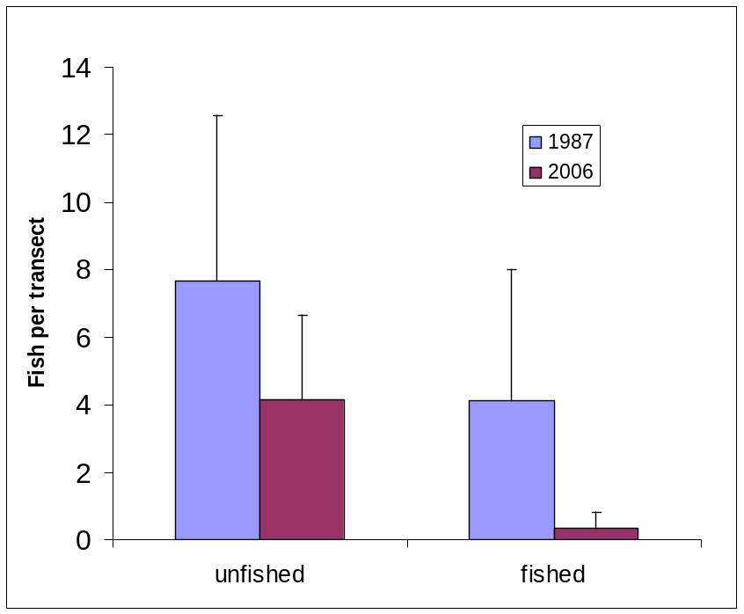
Twenty years at Osprey Sanctuary: 1987-2006
half as many Lethrinus nebulosus inside the old sanctuary zone
greater difference outside the sanctuary

Slide 9
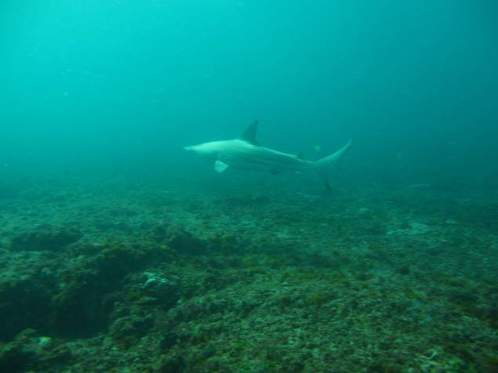
Relating fish abundance to human usage

Slide 10
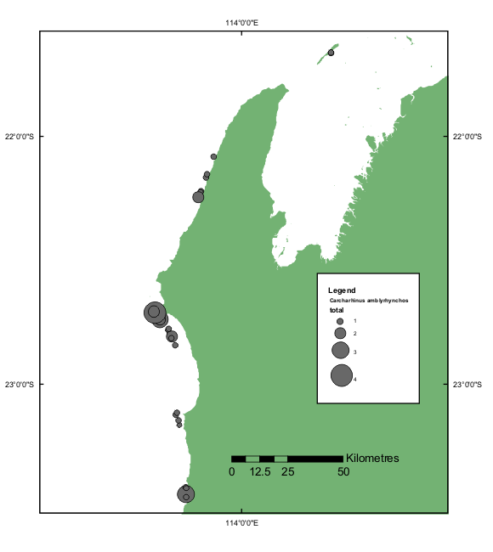
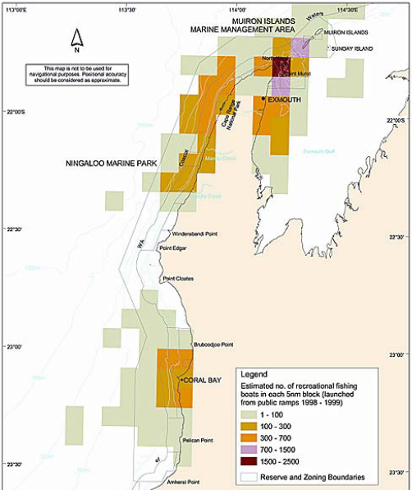
Relating fish abundance to human usage
Grey Reef Shark
Recreational fishing

Slide 11
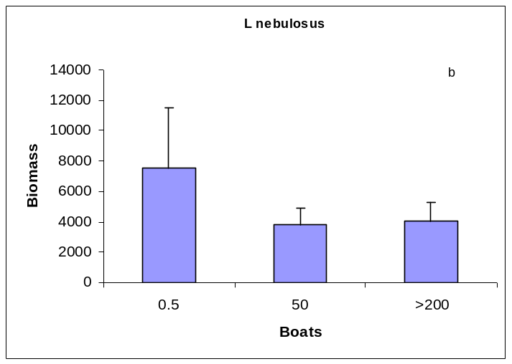
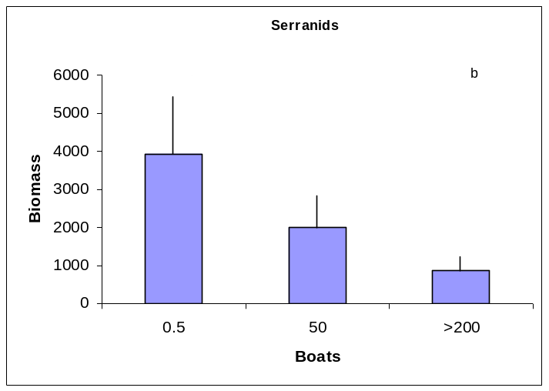
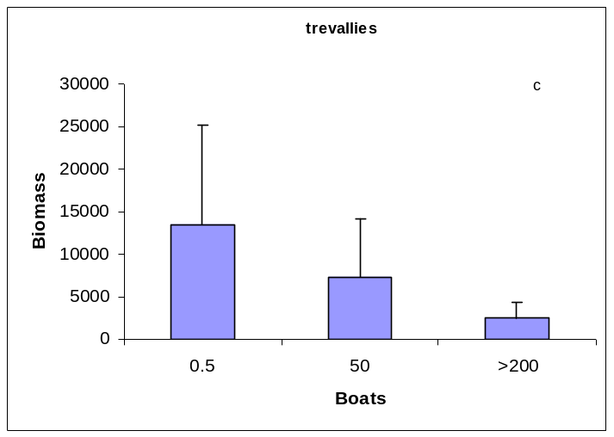
Fishing pressure and target species biomass
Grey Reef Shark
Spangled Emperor
Serranids
Carangids

Slide 12
Adequacy of sanctuaries:
fish behaviour and habitat use

Slide 13
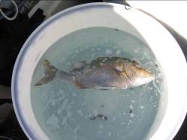

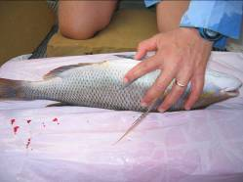
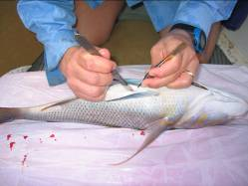
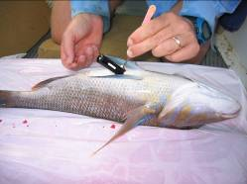
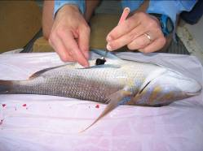
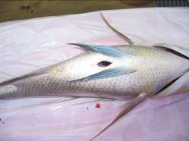
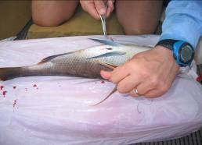
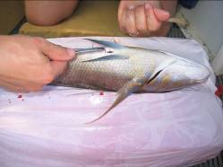

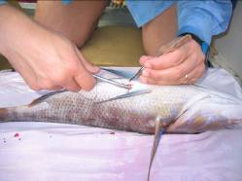
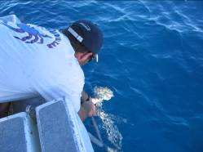
Acoustic Tagging and Tracking
Inserting an acoustic tag into a spangled emperor – less than 4 minutes

Slide 14
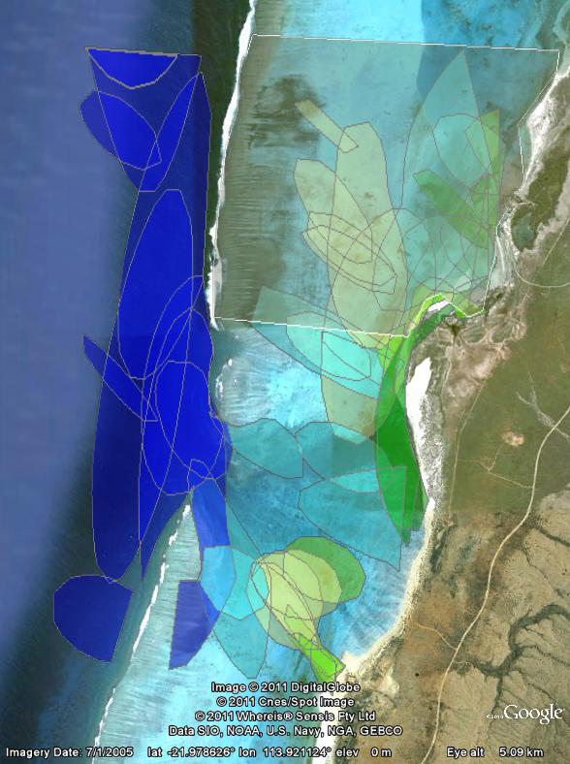
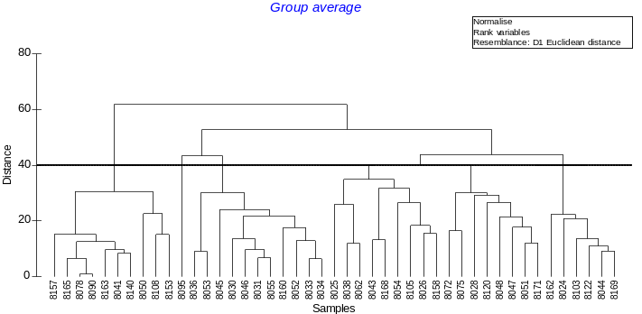
Population spatial usage and individual 50% Home Ranges
Sanctuary
Results based on 63 individuals
45 (71%) stayed in the array for long enough to calculate centre of activity
others left after shorter periods of time (29%)
multiple behavioural modes?
Notes:
What do shadings in 50% HR mean?

Slide 15
Zoning adequacy and fish movement
Spangled Emperor
Some fish stay in a sanctuary all the time, many fish range more widely, moving across boundaries
Details of the scale of fish habitat use and habitat preferences can now be used to aid the design of sanctuary zones within multiple use marine parks
Populations are connected and this needs to be considered as part of the trade-offs between on-reserve and off-reserve management

Slide 16
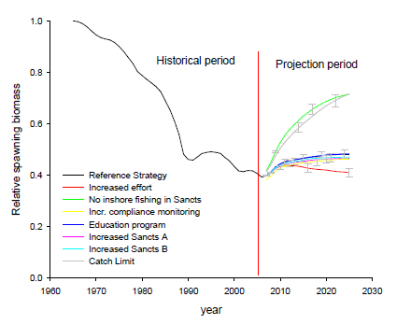
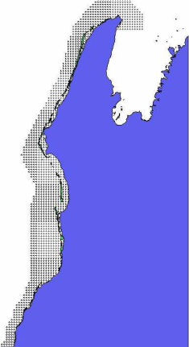
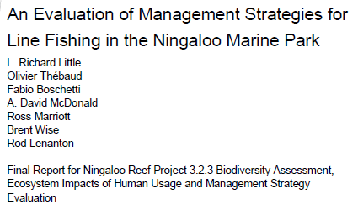
Integrating conservation and fisheries perspectives at Ningaloo
Overall changes are likely needed to maintain Spangled Emperor populations in the park, even with current re-zoning
ELF population model 1544 1 minute grid cells

Slide 17
Summary: effects on fish species
Are Ningaloo’s Sanctuary zones effective?
Evidence for Sanctuary Zones having positive effect on some target species
Need to re-evaluate desirability of shoreline fishing access zones
Stronger effects of fishing across the park in general; sanctuary zone scheme may not be sufficient on its own
The Future
Broad Baselines for measurement of future trends and responses in sanctuary zones and in the park overall
Collaborative ongoing monitoring and research for new information in future conservation initiatives

Slide 18
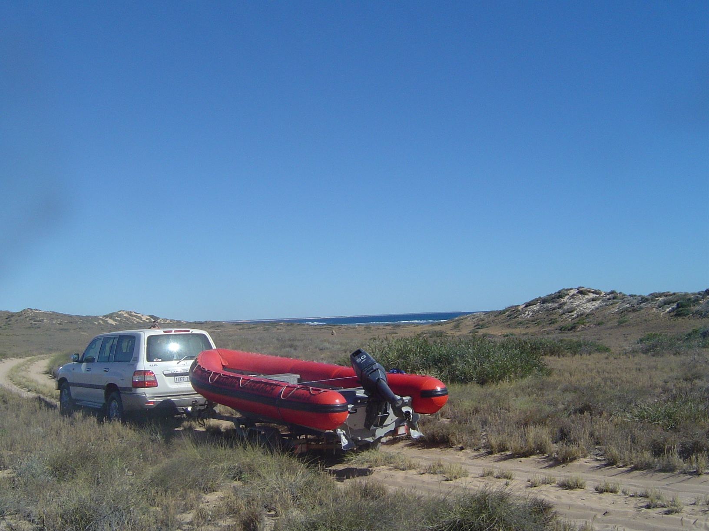
Acknowledgements
WA Dept of Environment and Conservation
WA Dept of Fisheries
WAMSI – WA Marine Science Institution
Tony Ayling
Bill de la Mare and CSIRO WfO Flagship
Charlie Huveneers & Andrew Boomer, IMOS AATAMS Facility

Slide 19
Thank you
CSIRO Marine and Atmospheric Research
  Russ Babcock
  Presenter Title
    t +61 7 9333 5904
    e Russ.Babcock@csiro.au
    w www.csiro.au/lorem
CSIRO Marine and Atmospheric Research From Oceans Flagship

Slide 20
Comprehensiveness and Representativeness:
Ningaloo fish assemblages

Slide 21
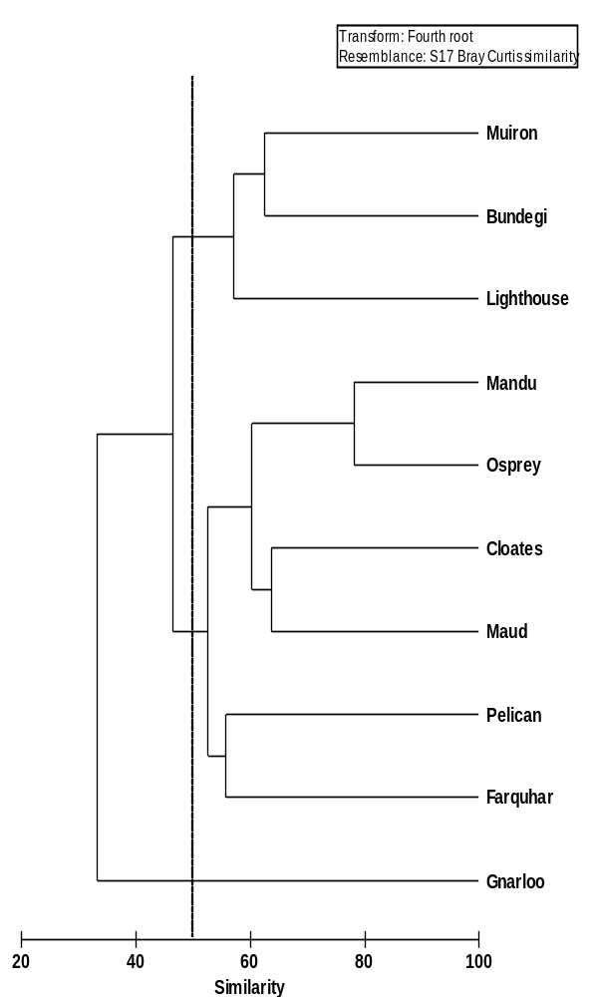
Regional trends in fish assemblage structure
Reef slopes

Slide 22
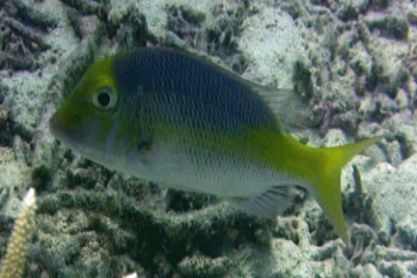
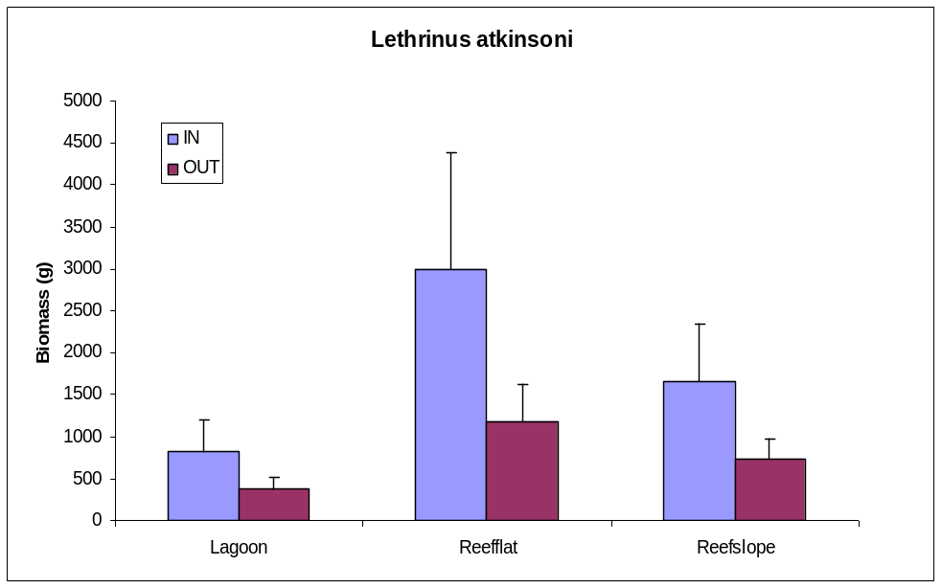
Zoning effects
Yellowtailed Emperor biomass 100% greater in old sanctuary zones (p=0.014)
Across all habitats

Slide 23
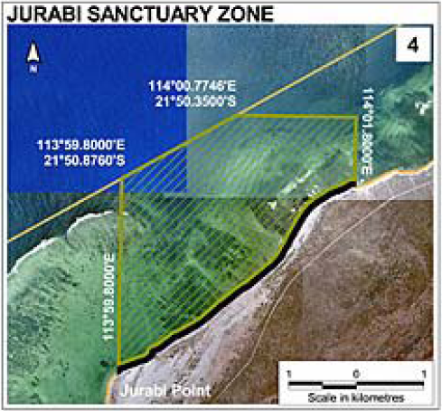
Model system: Ningaloo Marine Park
Complex zoning,
habitats represented unevenly
Is zoning adequate?
e.g. MPA that allows shoreline fishing and
Does not include reef slope habitat

Slide 24
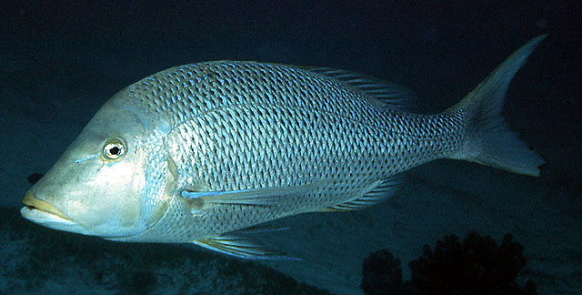
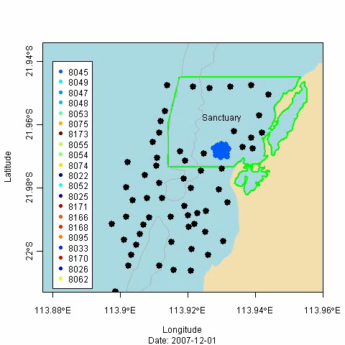
Movement of spangled emperor

Slide 25
Marine Park zoning and target species
Zoning is working, but…..
working differently for different species,
doesn’t seem to have stopped a general decline in target species
No silver bullet - effective management of the whole park may need to consider more active management outside no-take areas
Ongoing information required at both sanctuary and whole-of-park level

